Slide 1
An introduction
to
new generation
smart meter

Slide 2
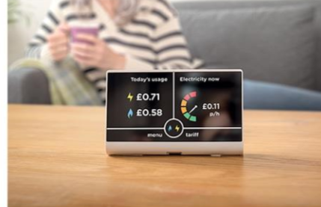
What is a smart meter ?
Smart meters are the latest generation of gas and electricity meters which will replace your traditional meters.

Slide 3
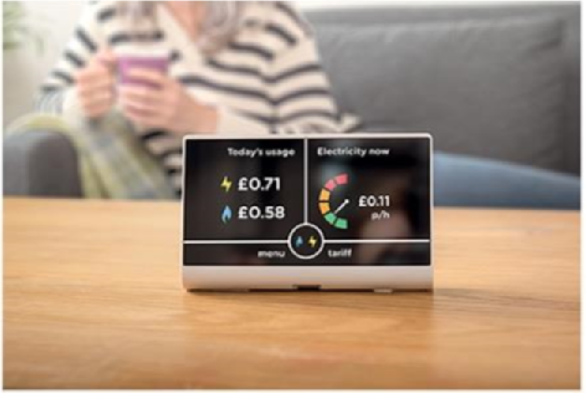
What is an In house Display: IHD Device & its features
A portable in-home display Device, that clearly shows, you how much energy you’re using, and how much it’s costing you

Slide 4
What is an In house Display: IHD Device & its features
2. Both parts communicate with each other automatically, and send your energy usage information to your energy supplier

Slide 5
IHD Device & its features
Your in-home display is a handheld device which can sit anywhere in the home, which means you can always see your energy usage at a glance.

Slide 6
IHD Device & its features
your meter automatically sends your readings to your energy supplier, there’s no more rooting around in meter cupboards or having someone visit your home to read them. That makes life easier for a start.
When there is energy breakdown at home it automatically communicates the situation with supplier hence making life more easier specially in harsh winters

Slide 7
ARE THEY SECURE?
Designed with some of the country’s most senior security experts, smart meters operate on their own secure wireless network, so there’s no need to be connected to the internet. Your name and address are not stored.

Slide 8
IS IT A HASSLE TO GET ONE?
Getting a smart meter is actually pretty easy, and they’re provided at no extra cost.
There are a few important things you’ll need to prepare before your installation:

Slide 9
Smart meter installation processes
• Agree a time and date with your supplier that you can be home for the installation. An installer will never turn up unexpectedly.
• Make sure you know where your current meters are and take steps to ensure they’re accessible for the installer.

Slide 10
Smart meter installation processes
• The installer should present you with a valid identity card upon arrival, which you can ask to see if the installer does not present it upfront.
• It takes about two hours and your energy supply will be cut off for a short period, but you’ll need to be present for the installation.

Slide 11
Safety Check and Initial demonstration
• The installer will perform a safety check on your gas appliances as part of your installation.
• Once fitted, your installer will show you how to use your in-home display and offer energy-saving advice

Slide 12
Could energy data transform healthcare? Future use
The smart meter rollout will create a broad platform for innovation thanks to the detailed data generated by households.
Potential uses of smart energy data
Ongoing monitoring of conditions
Alerting relatives or care professionals
Aiding diagnosis
Aggregate data analytics

Slide 15
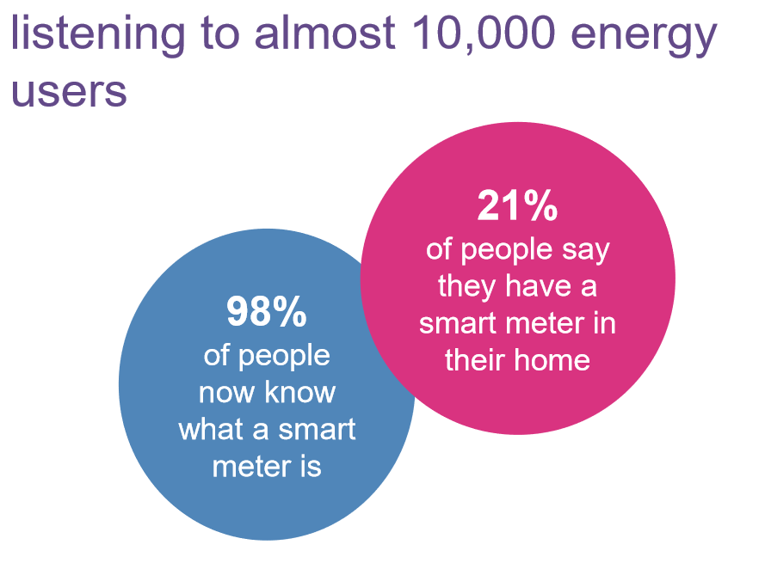
listening to almost 10,000 energy users
19 million people who haven’t got a smart meter want one in the next six months
98% of people now know what a smart meter is
21% of people say they have a smart meter in their home

Slide 16
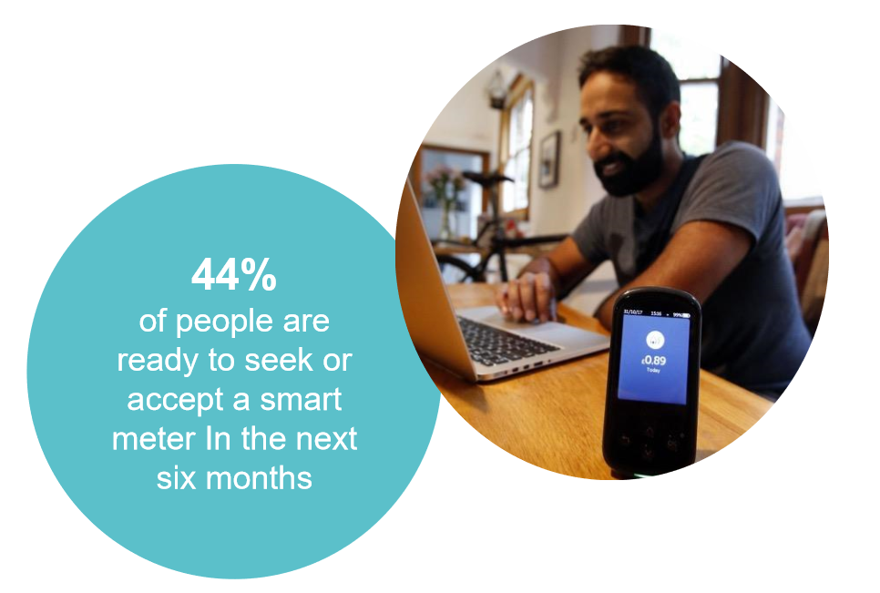

Slide 17
What about you?
If you want, NKS-CCF team to work for you,
for the purpose
please feel free to contact us

