Slide 1
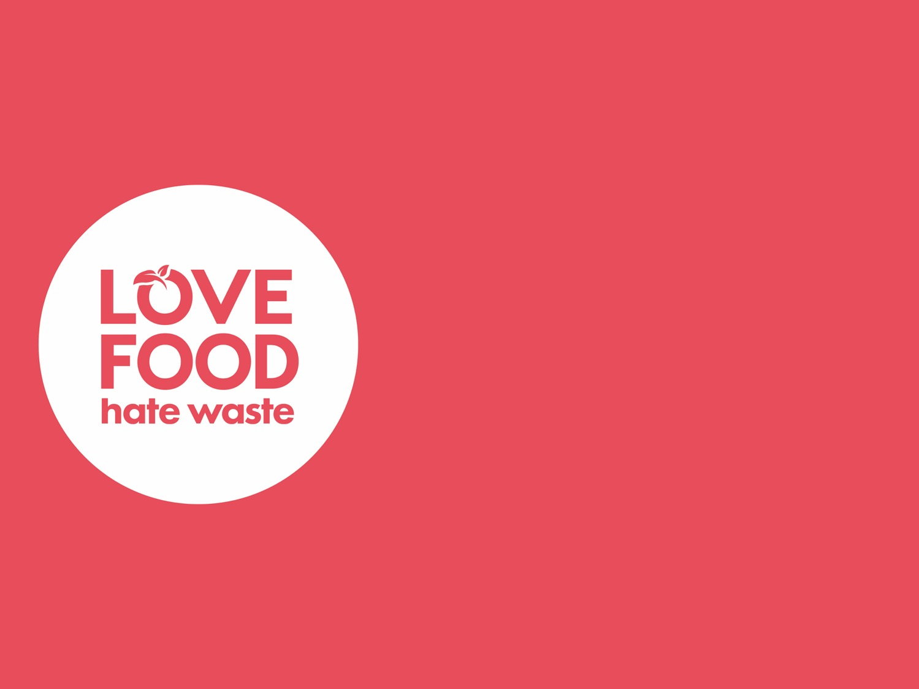
Low Carbon Communities Initiative
Networking Key Services- NKS
Use maximum of food you buy

Slide 2
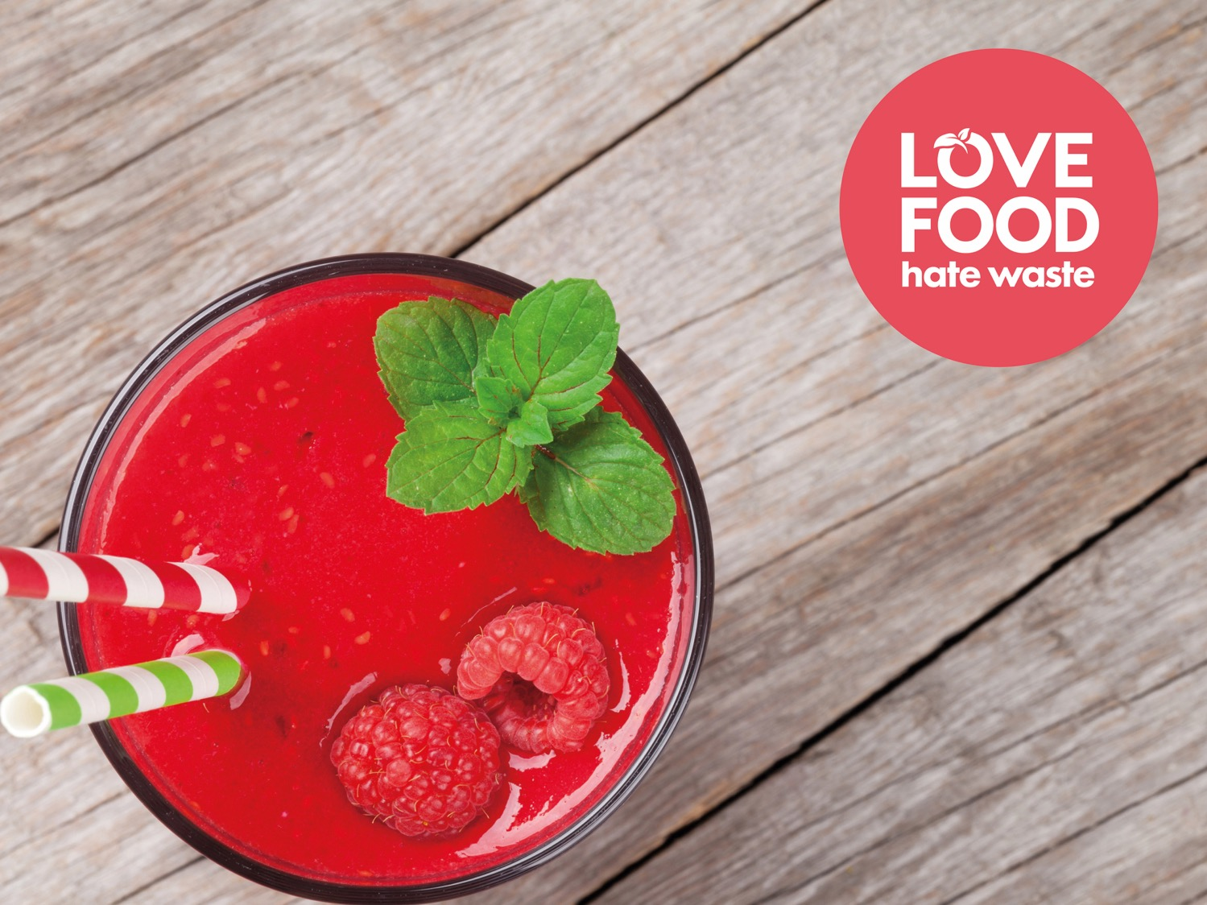
Presentation title
Presenter
Date

Slide 3
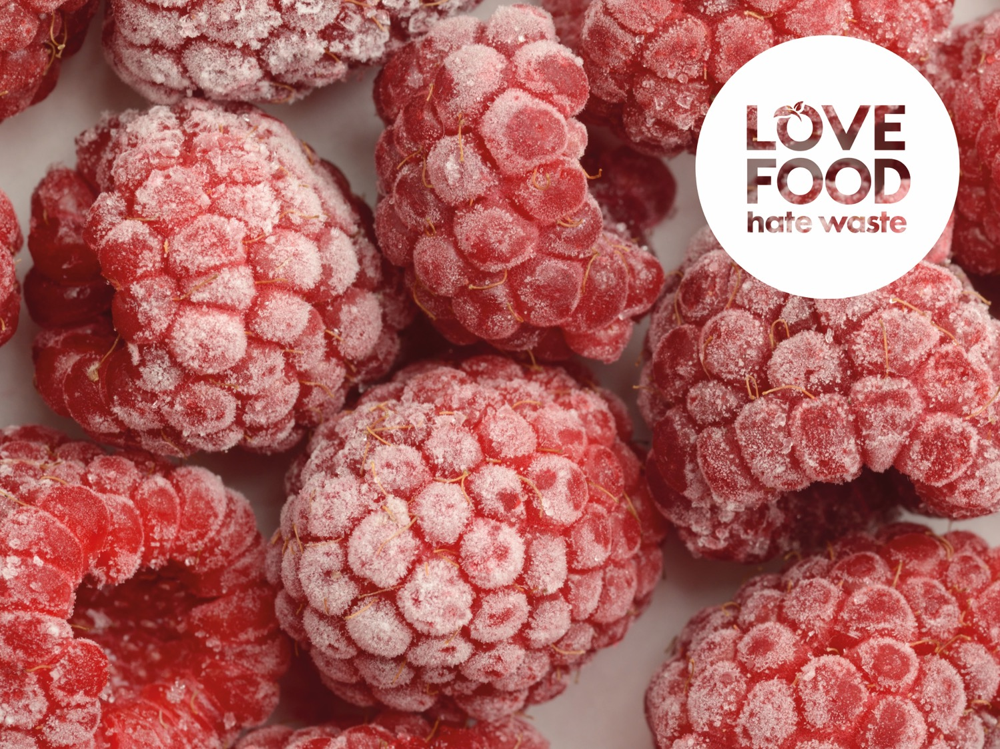
Presentation title
Presenter
Date

Slide 4
Love Food Hate Waste works to reduce food waste by raising awareness of its environmental and economic impact. The campaign provides practical advice for householders to throw out less food and save money, focusing on the most commonly wasted food groups including; bakery, dairy, fresh fruit, meat and fish, and fresh vegetables and salad.
The campaign is run by Zero Waste Scotland, the delivery body set up by
the Scottish Government to help people and organisations on the journey to zero waste.

Slide 5
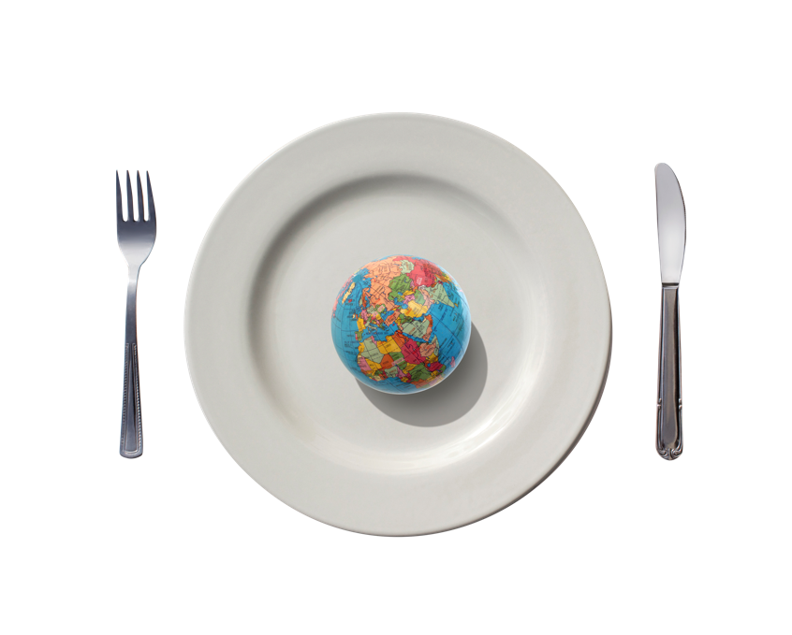
Food waste: The big picture
1/3 of the world’s food is wasted
Producing, distributing, storing and cooking food uses energy, fuel and water
Each of these emits greenhouse gases contributing to climate change
Food waste sent to landfill gives off methane gas – 25x more damaging than carbon dioxide

Slide 6
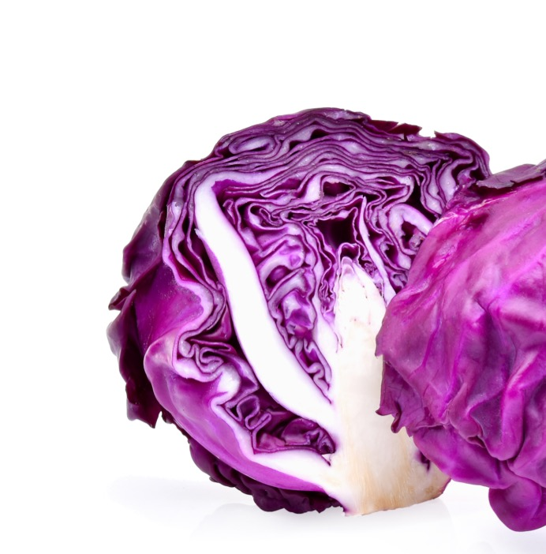
Food facts
Did you know?
Almost 50% of all food waste in Scotland comes from households. We throw away 600,000 tonnes of food and drink from our homes every year in Scotland, and more than half of this is food and drink we could have eaten.
Wasting this food costs the average household
£460 a year, the equivalent of around
£38 a month.

Slide 7
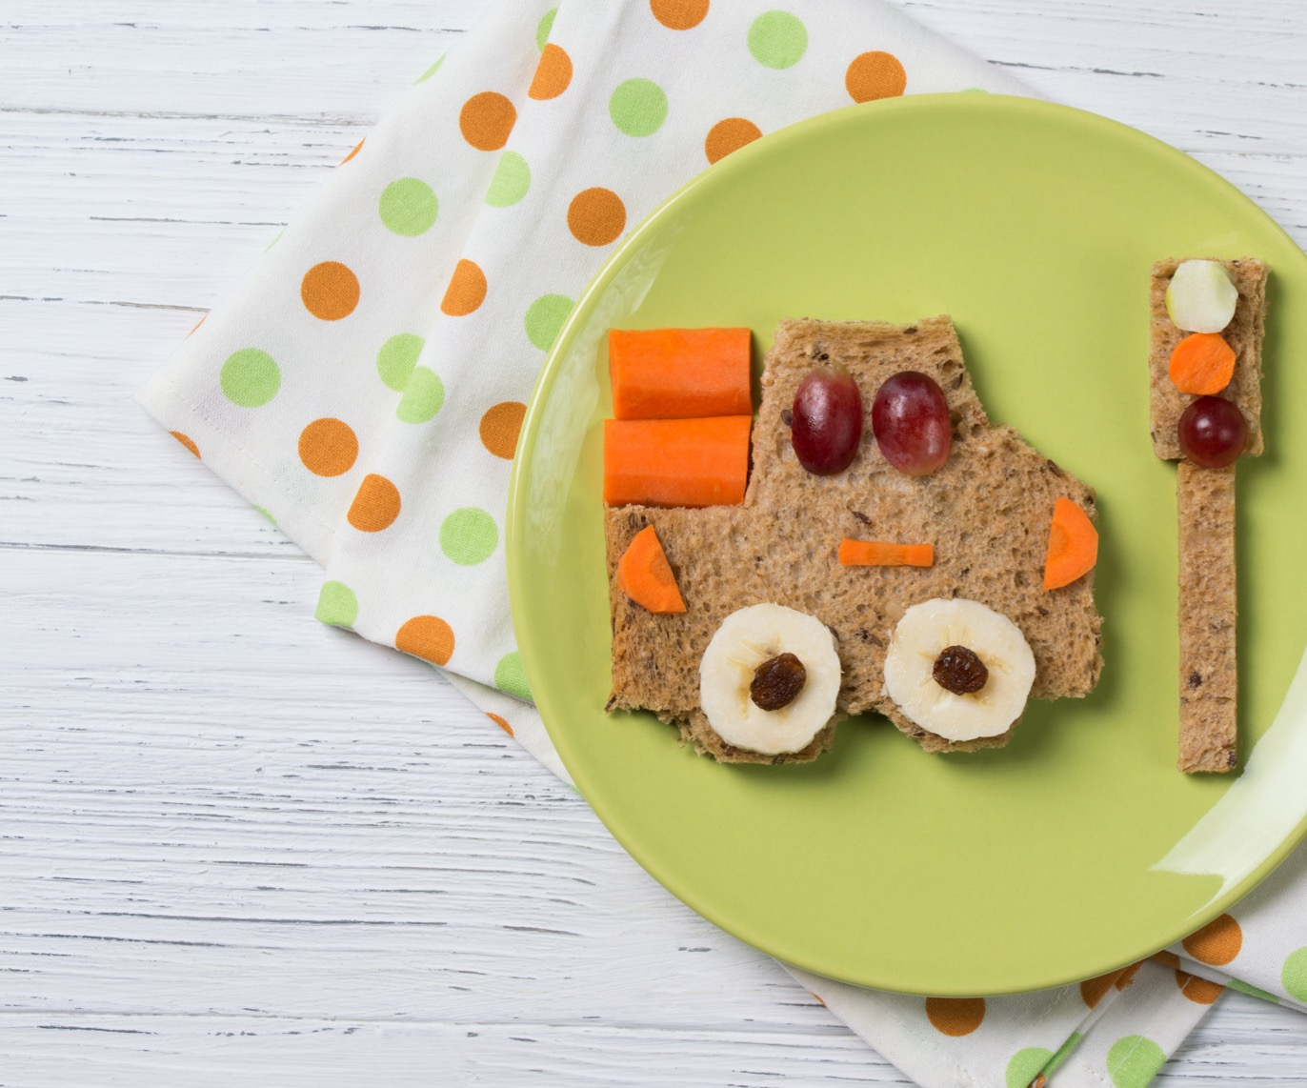
Environmental impact
If we all stop wasting food that could have been eaten, the benefit to the planet would be the equivalent of taking 1 in 4 cars off the road.
Did you know?
The waste of good food and drink is associated with 4% of Scotland’s total water footprint.

Slide 8
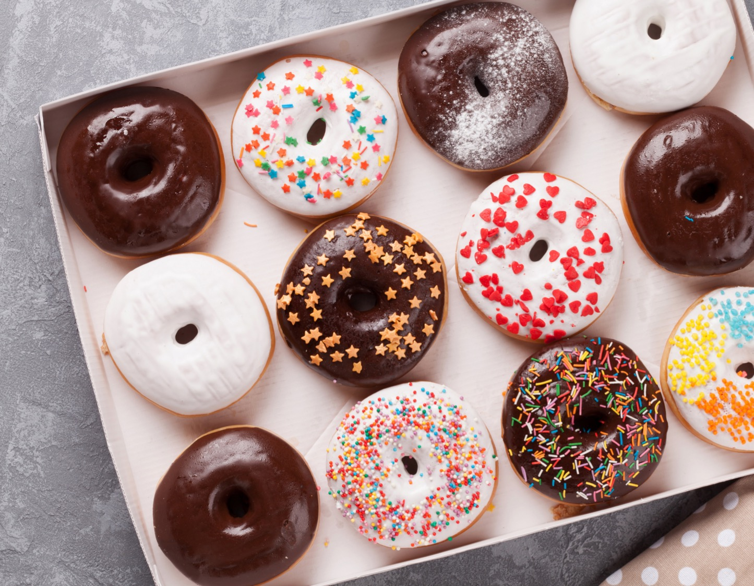
Why is it wasted?
There are two main reasons why we throw away good food: we cook or prepare too much or we don’t use it in time.
The foods we waste the most are fresh vegetables and salad, drink, fresh fruit, and bakery items such as bread and cakes.
Did you know?
We throw away more food from our homes than packaging in Scotland every year.

Slide 9
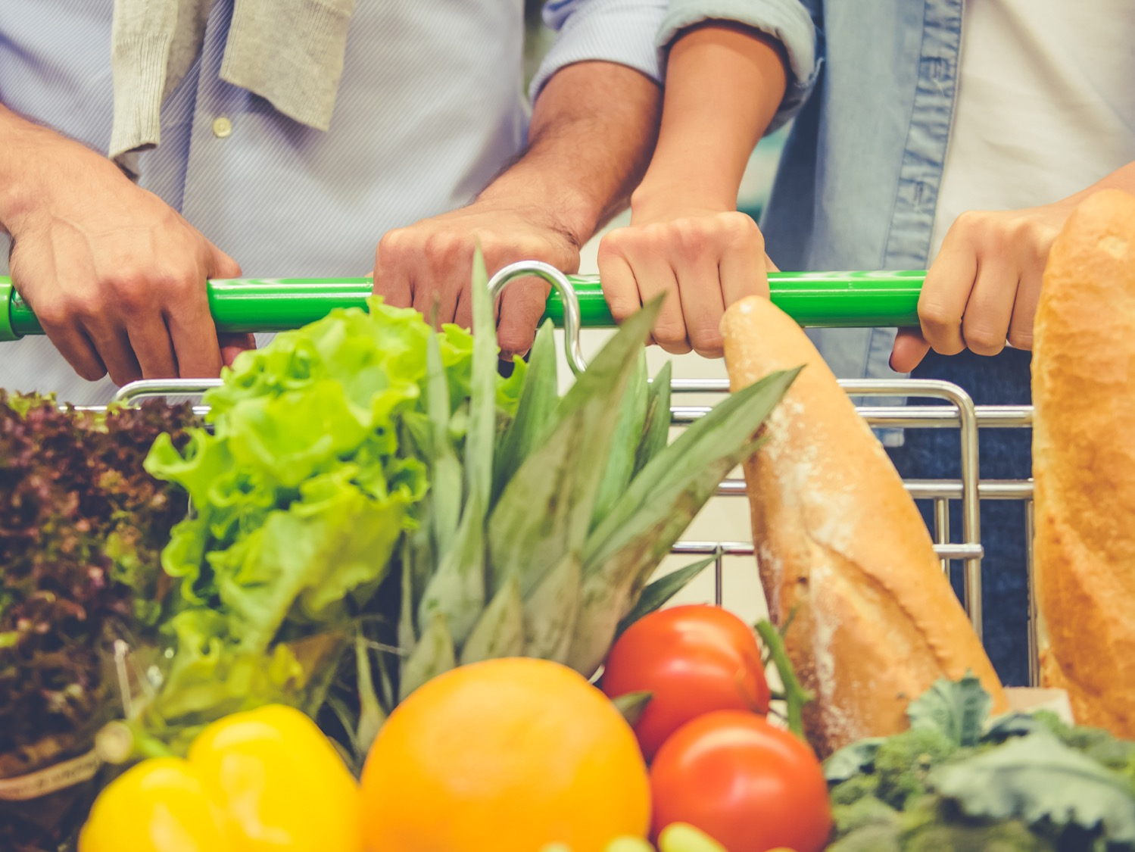
REMEMBER…
With rising food prices, Love Food Hate Waste really can help you
save money every week.

Slide 10
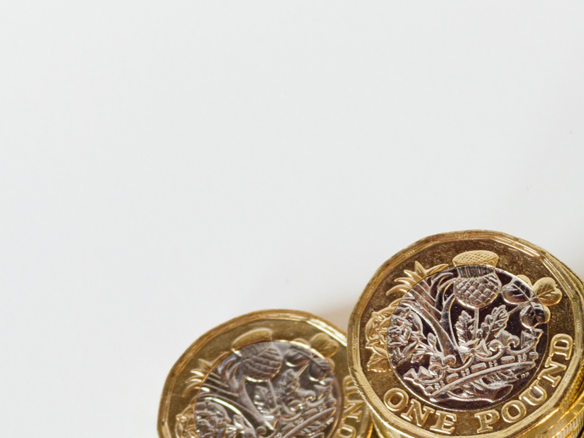
How much could I save?
£41.40 /11 = £3.80 per person
£198 = per year / person
In line with national average

Slide 11
In Scotland we throw away:
Dairy
£63 million of dairy waste every year = enough milk for half a million bowls of cereal every day.
85,000 litres of milk is thrown out untouched.
That’s the output of
1300 cows.

Slide 12
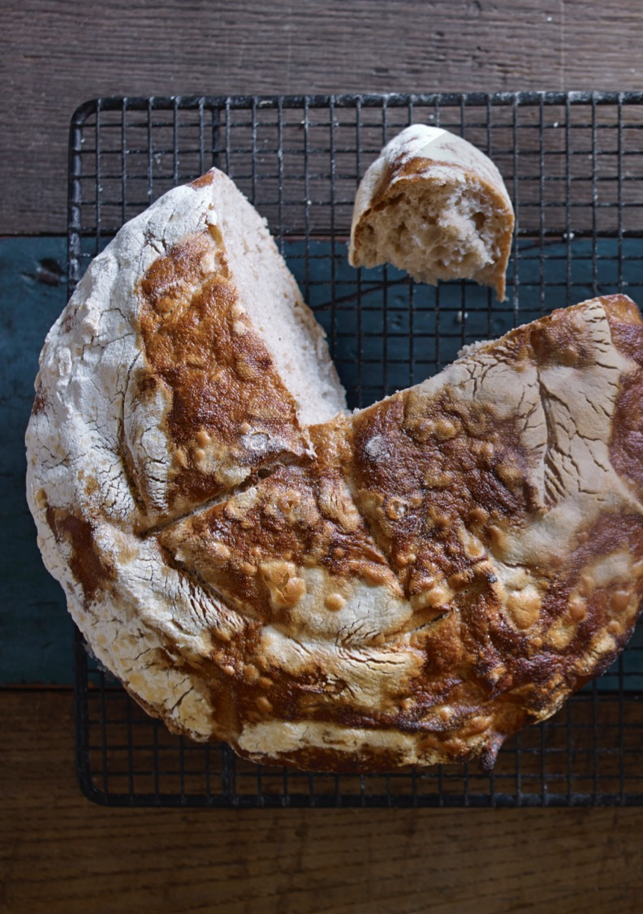
Bakery
£76 million of bakery waste every year
= enough to make 800 million sandwiches.
Over 2 million slices of bread is thrown out each day in Scotland.

Slide 13
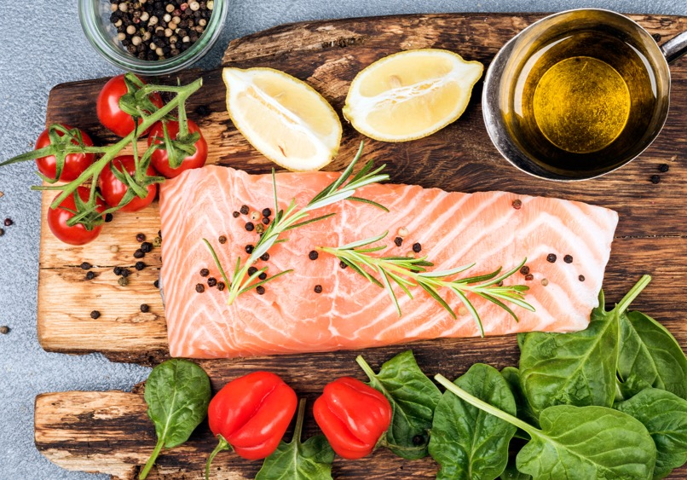
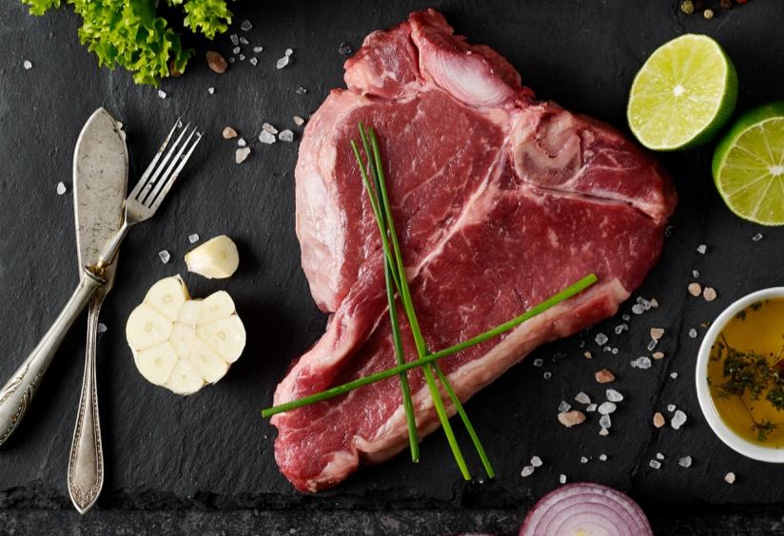
Fresh Meat and Fish
£130 million every year
= enough to make everyone in Scotland a bacon buttie every Saturday for the next year.

Slide 14
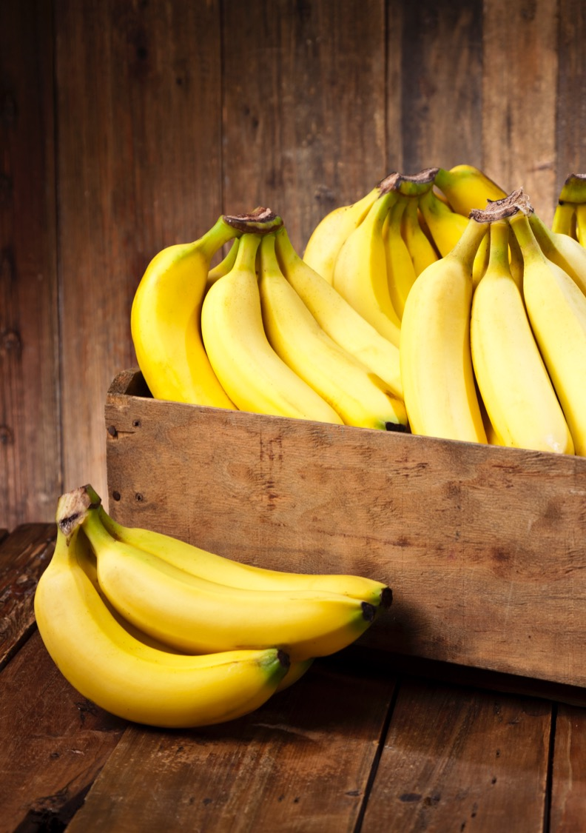
Fruit
£79 million of fresh fruit waste is thrown away every year
= enough to give everyone in Scotland an apple a day for a month.

Slide 15
Drinks
£110 million of drink is thrown away every year = that’s enough to buy 330 million glasses of orange juice, which would meet vitamin C requirements for everyone in Scotland for 8 months.
63,000 litres of fizzy drinks are thrown out.
That’s 165,000 cans.

Slide 16
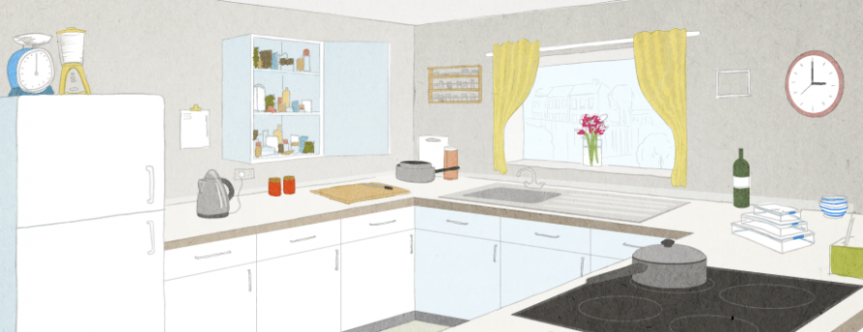
Why do we waste food?
Two thirds of what is thrown away could have been eaten if we had simply managed it better
1
We don’t check our cupboards so over buy.

Slide 17
Why do we waste food?
Two thirds of what is thrown away could have been eaten if we had simply managed it better
2
Not sure what date labels mean or don’t keep a check on them.

Slide 18
Why do we waste food?
Two thirds of what is thrown away could have been eaten if we had simply managed it better
3
Over generous portioning ends
in leftovers.

Slide 19
Why do we waste food?
Two thirds of what is thrown away could have been eaten if we had simply managed it better
4
Not making full
use of our freezers.

Slide 20
Why do we waste food?
Two thirds of what is thrown away could have been eaten if we had simply managed it better
5
Not using up
our leftovers.

Slide 21
Low Carbon Communities Initiative
Networking Key Services- NKS
What can you do?
Planning your meals is one of the best ways to cut food waste. Before you go shopping check what’s in your fridge, freezer and store cupboard.
Write a shopping list before you head out and stick to it – it can save time and money.
It pays to plan

Slide 22
Low Carbon Communities Initiative
Networking Key Services- NKS
What can you do?
The ‘use by’ date is key in terms of food safety. Never eat food after this date. ‘Best before’ dates refer to quality rather than food safety.
You can ignore the ‘display until’ date, it’s there to help shop staff with stock control.
Know your dates

Slide 23
Low Carbon Communities Initiative
Networking Key Services- NKS
What can you do?
Getting to know your freezer
You don’t have to freeze food on the day you buy it – you can freeze it anytime before the ‘use by’ date then defrost and use within 24 hours.

Slide 24
Low Carbon Communities Initiative
Networking Key Services- NKS
What can you do?
Savvy storage
Always follow the storage guidance on food packs to enjoy your food at its best.

Slide 25
Low Carbon Communities Initiative
Networking Key Services- NKS
What can you do?
Make sure you use the right portions. An average-sized mug is great for measuring uncooked rice – one adult portion is about
a quarter of a mug.
Don’t worry if you cook too much food, you can freeze leftovers or eat them for lunch the next day.
Perfect portions

Slide 26
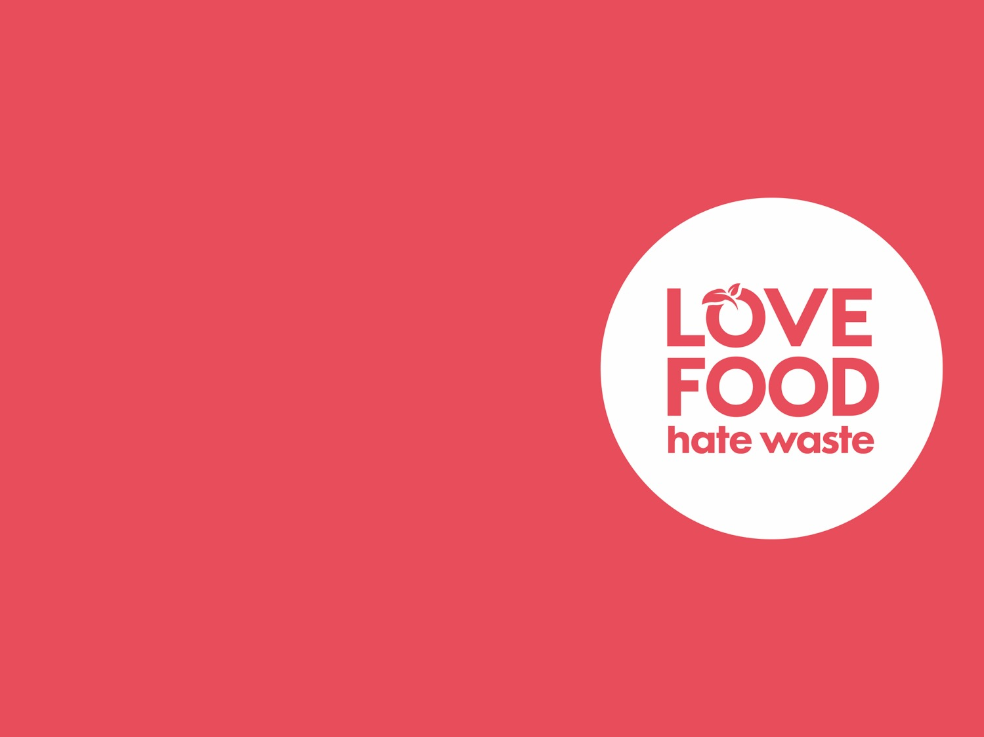
Low Carbon Communities Initiative
Networking Key Services- NKS
Thank you

